Slide 1
OASE
Get Rewarded For Your Work On Windows Phone

Slide 2
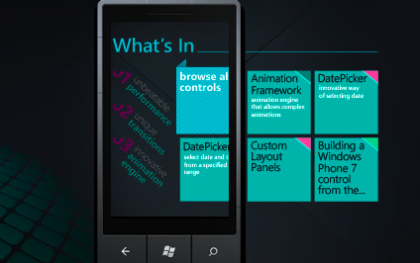
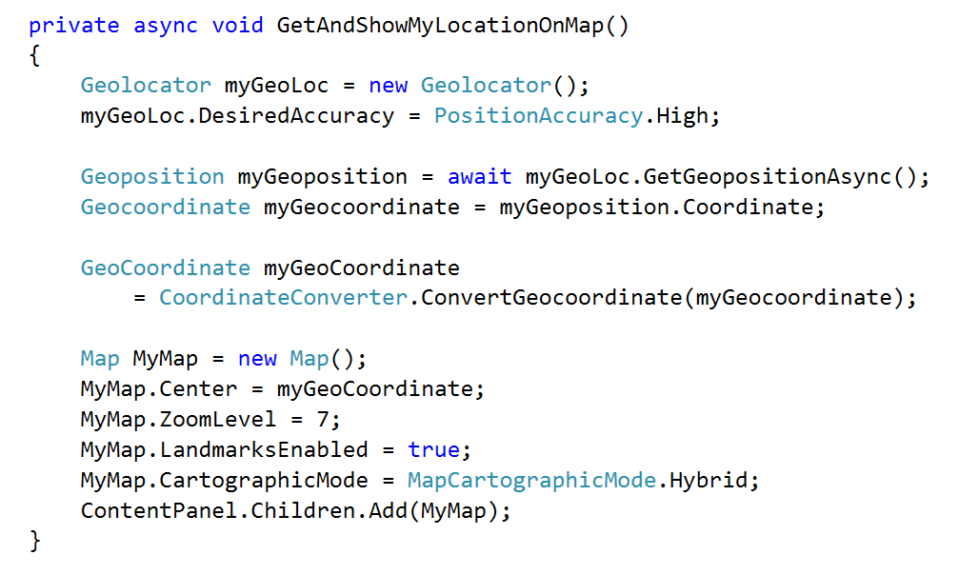
One App One Semester
Developer Class
.xaml.cs
Designer Class
.xaml

Slide 3
#AskDeveloper
0857-1784-9479 (sms/WA)
#AskDesigner
0897-772-9545 (sms/WA)
#AskAnalysis
08xx-xxxx-xxxx (sms/WA)

Slide 4
OUTPUT?

Slide 6
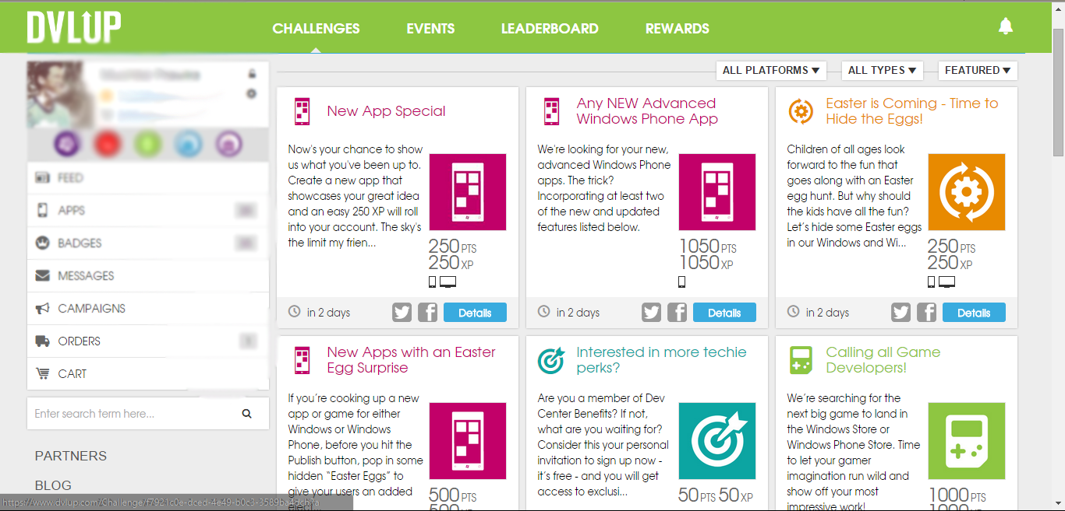

Slide 7
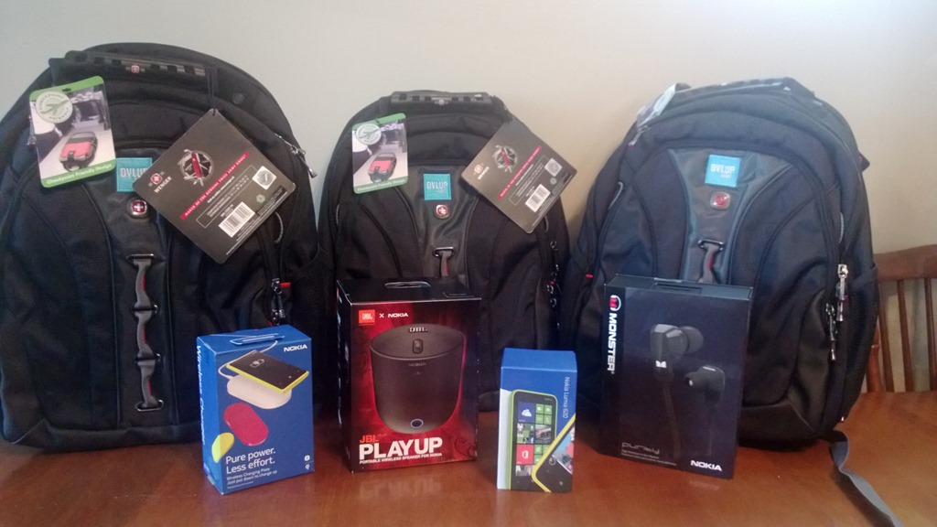

Slide 8
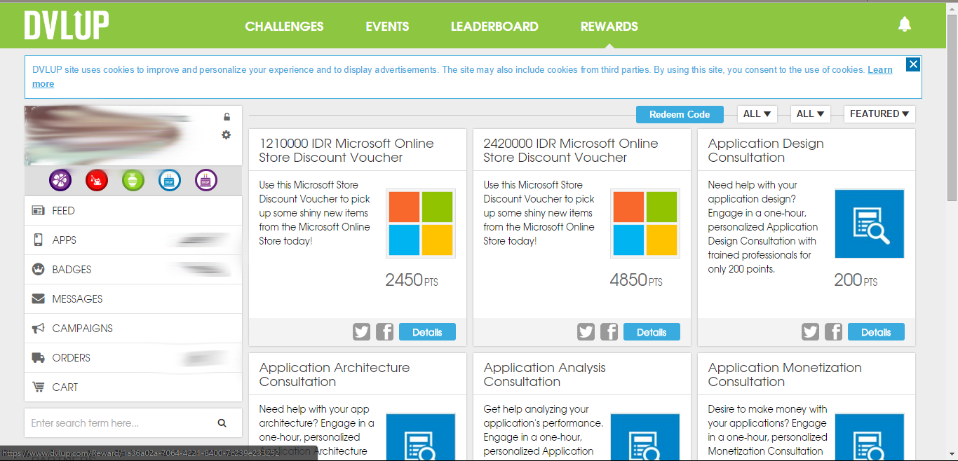

Slide 9
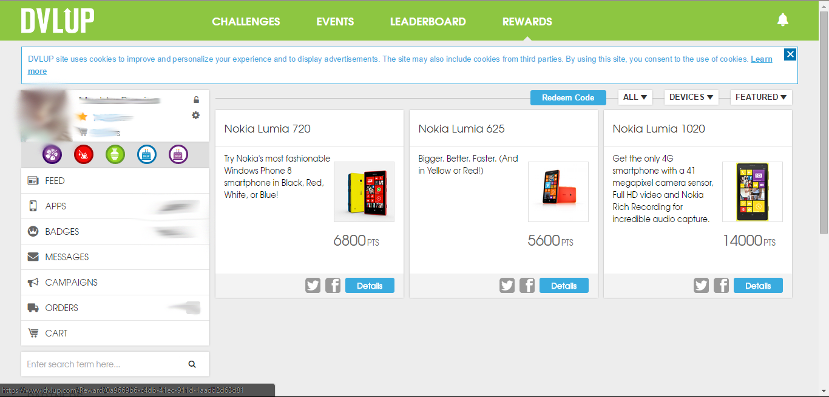

Slide 10
AND?

Slide 12
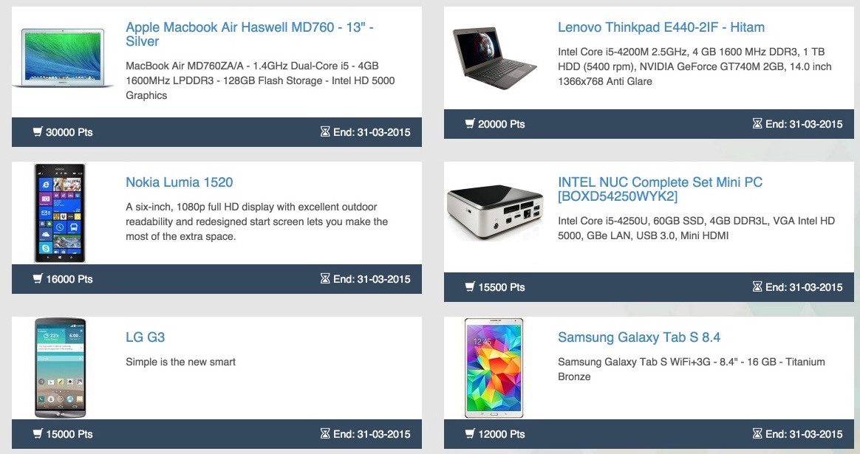

Slide 13
AND?

Slide 15
AND?

Slide 16
OASE REWARDS?

