Slide 1
Jokowi ahok social media volunteer
A Gubernatorial Election’s Campaign

Slide 2
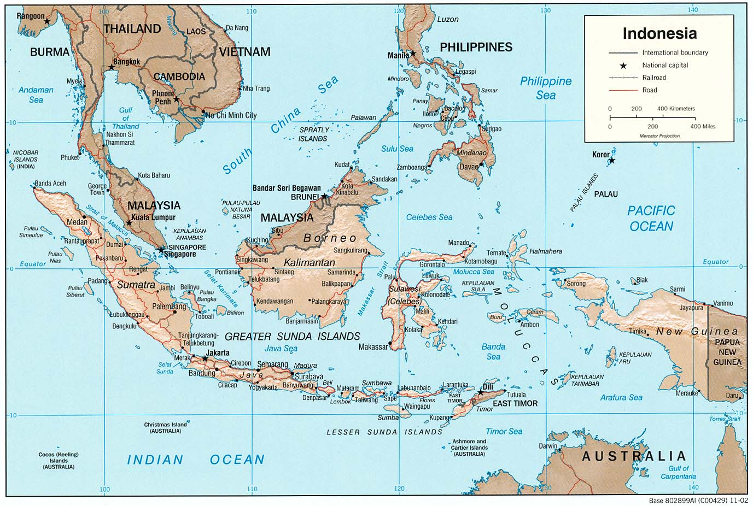
background
Indonesia has 51 Million Facebook User (socialbakers.com) and its equal with 21 percent of Indonesia Growth Population (IndSight.Me)

Slide 3
objectives
To introduce and build public awareness towards Jokowi and Ahok for Gubernatorial Election
To educate target public on Jokowi and Ahok vision and mission
To create target public interest to be volunteer and vote for Jokowi and Ahok

Slide 4
timeline
June | July | August | September
Pre-Campaign | LAUNCHING JASMEV | REGISTER JASMEV | VOTE JOKOWI AHOK
JASMEV CAMPAIGN

Slide 5
Volunteer message
Do
VOTE JOKOWI AHOK FOR THE BRIGHT FUTURE OF JAKARTA
VOLUNTEERING
NEW HOPE
FANDOM
EXTRAORDINARY LEADER
BRIGHT VISION AND MISSION
Think
Feel
Reason to believe

Slide 6
Social media plan
MONTH | FACEBOOK | TWITTER | SMS | BLOG | EMAIL
JUNE | BUZZ ABOUT JAKARTA BARU AND REVOLUSI MENTAL | BUZZ ABOUT JAKARTA BARU AND REVOLUSI MENTAL | BUZZ ABOUT JAKARTA BARU AND REVOLUSI MENTAL | BUZZ ABOUT JAKARTA BARU AND REVOLUSI MENTAL | BUZZ ABOUT JAKARTA BARU AND REVOLUSI MENTAL
JULY | LAUNCH JASMEV & REGITER VOLUNTEER | LAUNCH JASMEV & REGITER VOLUNTEER | LAUNCH JASMEV & REGITER VOLUNTEER | LAUNCH JASMEV & REGITER VOLUNTEER | LAUNCH JASMEV & REGITER VOLUNTEER
AUGUST | JASMEV GATHERING | JASMEV GATHERING | JASMEV GATHERING | JASMEV GATHERING | JASMEV GATHERING
SEPTEMBER | BIG BANG FLASH MOB & VOTE JOKOWI AHOK | BIG BANG FLASH MOB & VOTE JOKOWI AHOK | BIG BANG FLASH MOB & VOTE JOKOWI AHOK | BIG BANG FLASH MOB & VOTE JOKOWI AHOK | BIG BANG FLASH MOB & VOTE JOKOWI AHOK

Slide 7
Social media activities
Facebook
Create hype about to be volunteer for Jokowi and Ahok
Announcement Volunteer Gathering
Conversation about Volunteer Spirit and Viral Campaign
Twitter
Create hype about to be volunteer for Jokowi and Ahok
Announcement Volunteer Gathering
Conversation about Volunteer Spirit and Viral Campaign
Political Memes
Kaskus
Create hype about to be volunteer for Jokowi and Ahok
Announcement Volunteer Gathering
Conversation about Volunteer Spirit and Viral Campaign
Political Memes
Youtube
Create hype creative video about to be volunteer for Jokowi and Ahok
Conversation about Volunteer Spirit and Viral Campaign via Creatives Video
Political Memes Videos

Slide 8
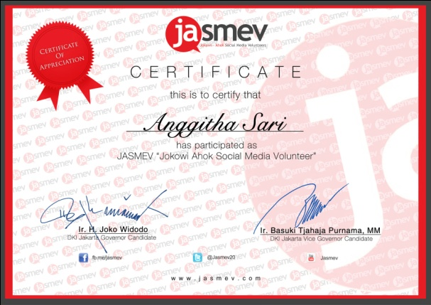
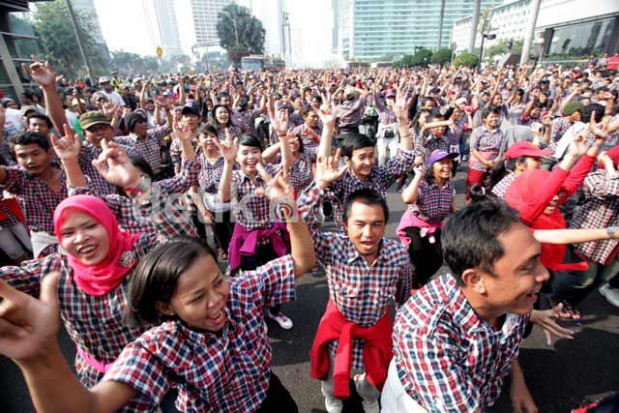
Social media campaign flow
SOCIAL MEDIA BUZZ
REGISTER JASMEV
VOTE JOKOWI AHOK
JASMEV GATHERING

Slide 9
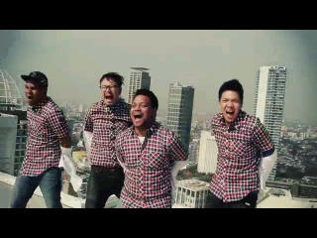
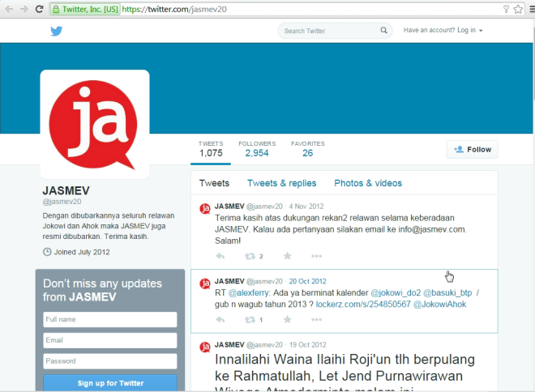
CAMPAIGN MATERIAL
SOCIAL MEDIA
BLOG COMPETITION
POLITICAL MEMES VIDEO

Slide 10
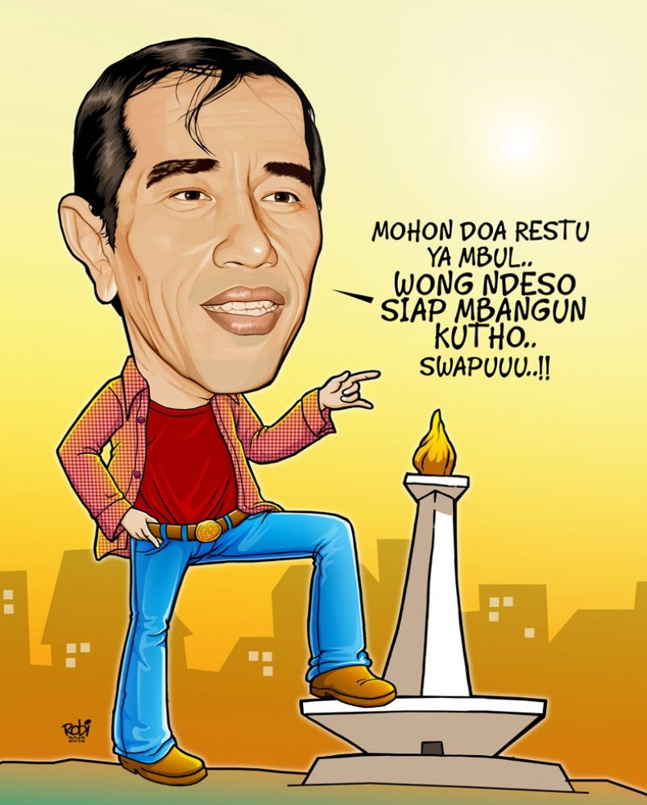
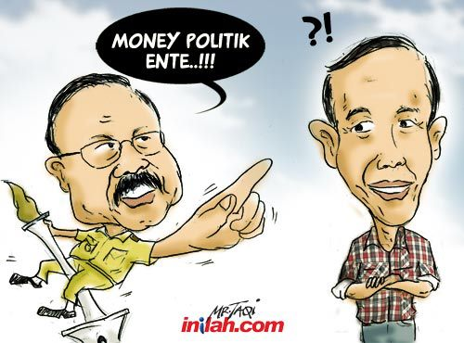
CAMPAIGN MATERIAL
MEMES
MEMES
POLITICAL MEMES

